Slide 1
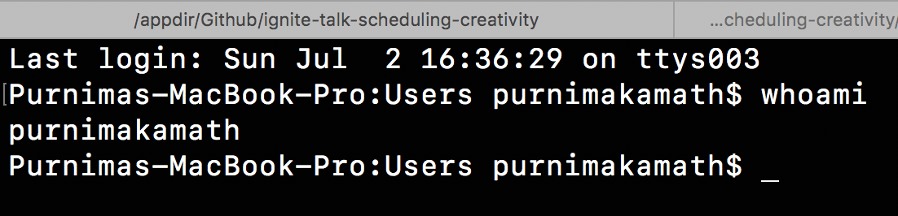

Client & Content
Technology

Slide 2
Not
really
my
topic
today
**But I really like to talk about it…

Slide 3
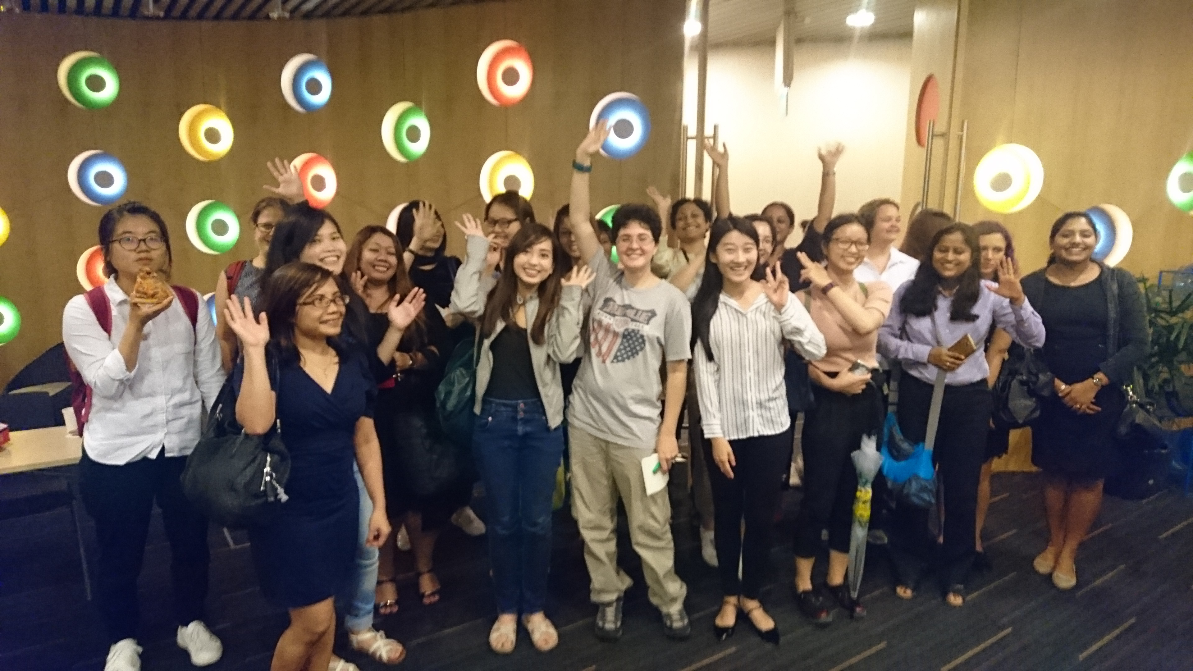
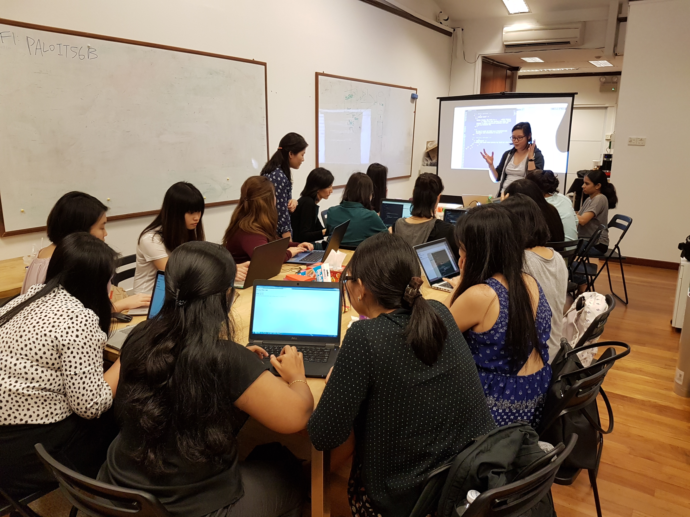
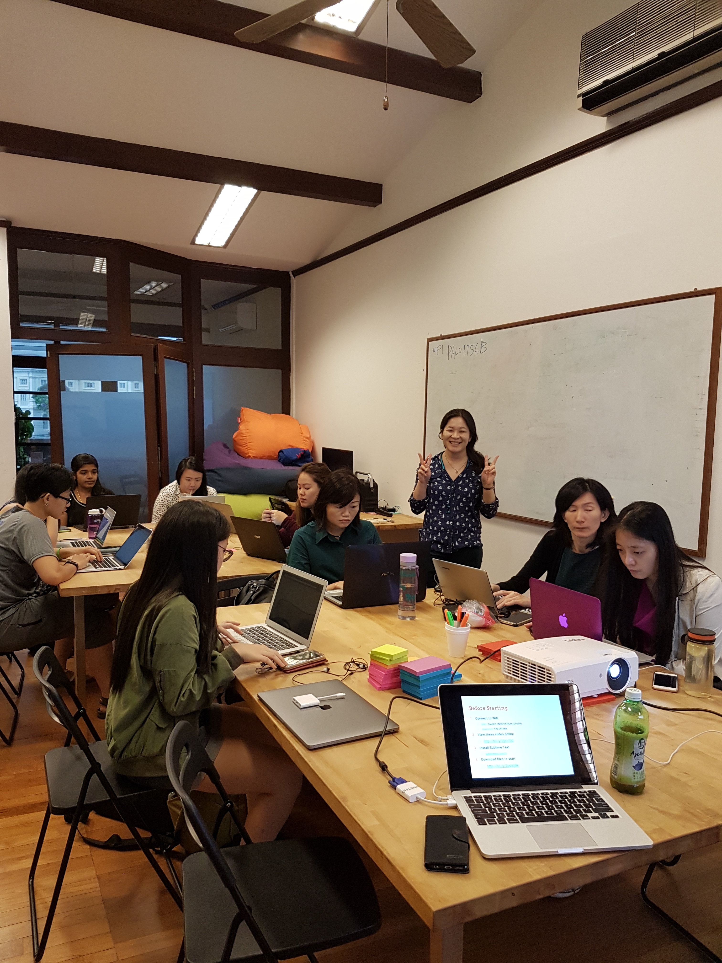
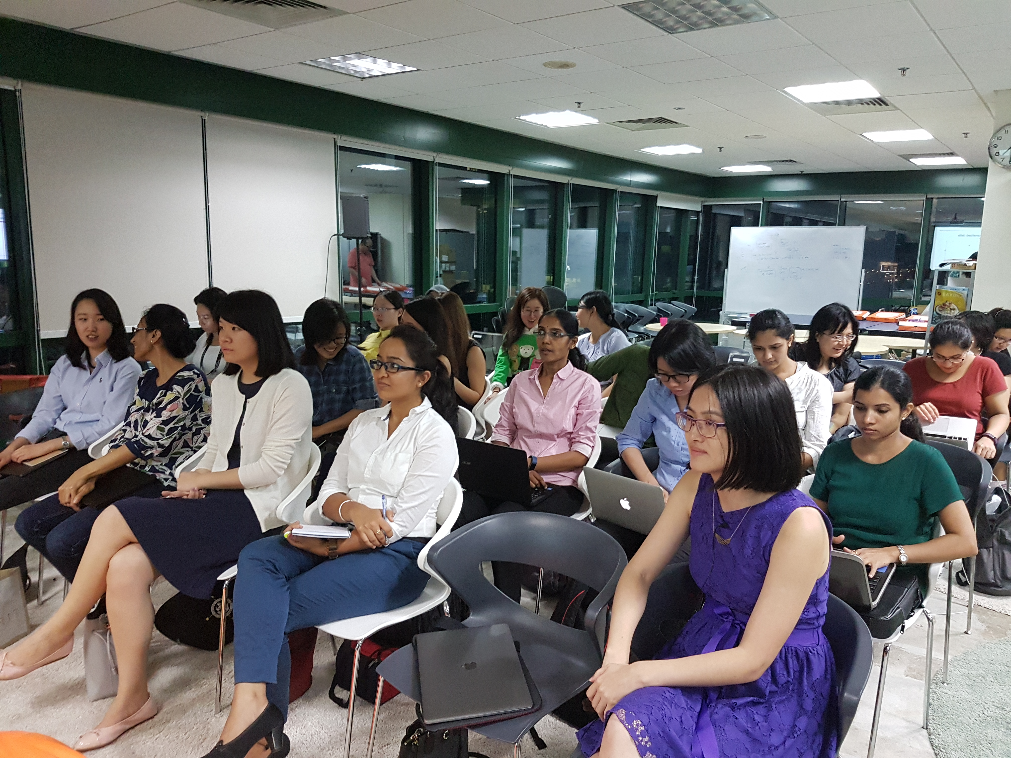
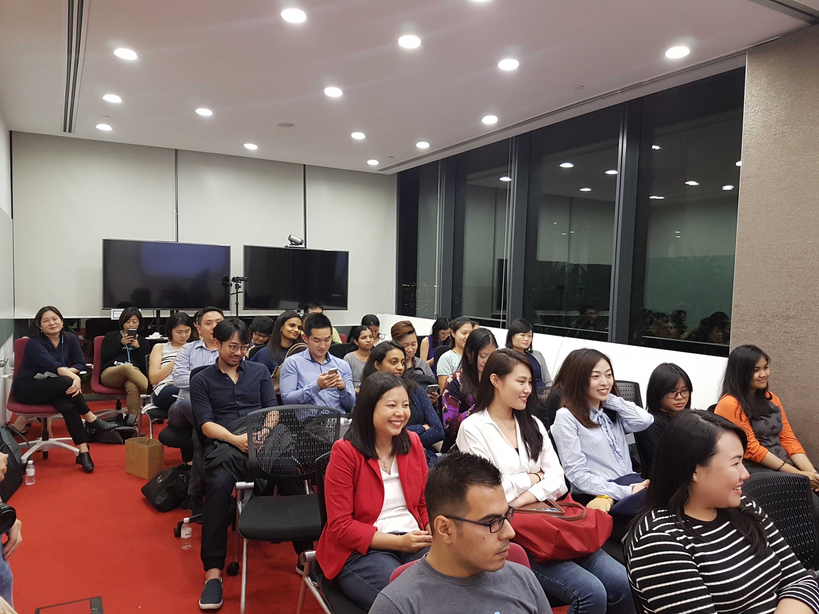

Slide 4


womenwhocode.com/singapore
@WWCodeSingapore
fb.com/wwcodesingapore

Slide 5
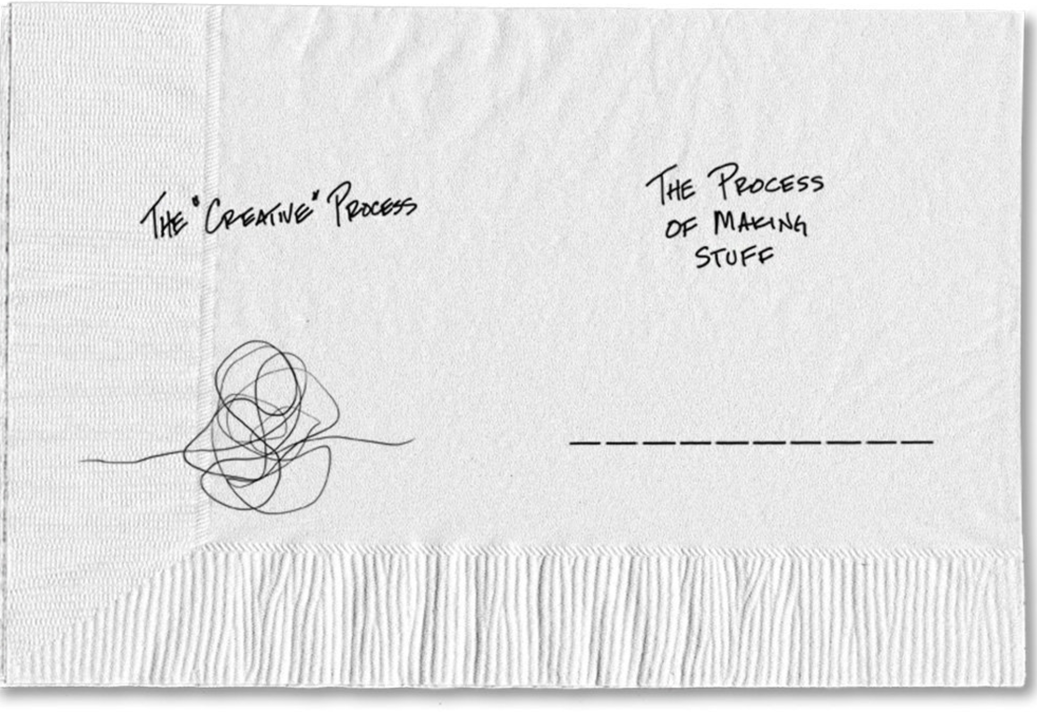

Sketch Guy

Slide 7

Benedict Cumberbatch
Vincent Van Gogh
Muse!!
Source: http://time.com

Slide 8


Slide 9

Invent an Obligation!
==================

Slide 10

Scheduling creativity for techies?

Slide 11
#100DaysOfCode

Slide 12


Slide 13


Slide 14
Pledge to code
One hour
Every single day
For 100 days only
** Outside of office hours

Slide 15
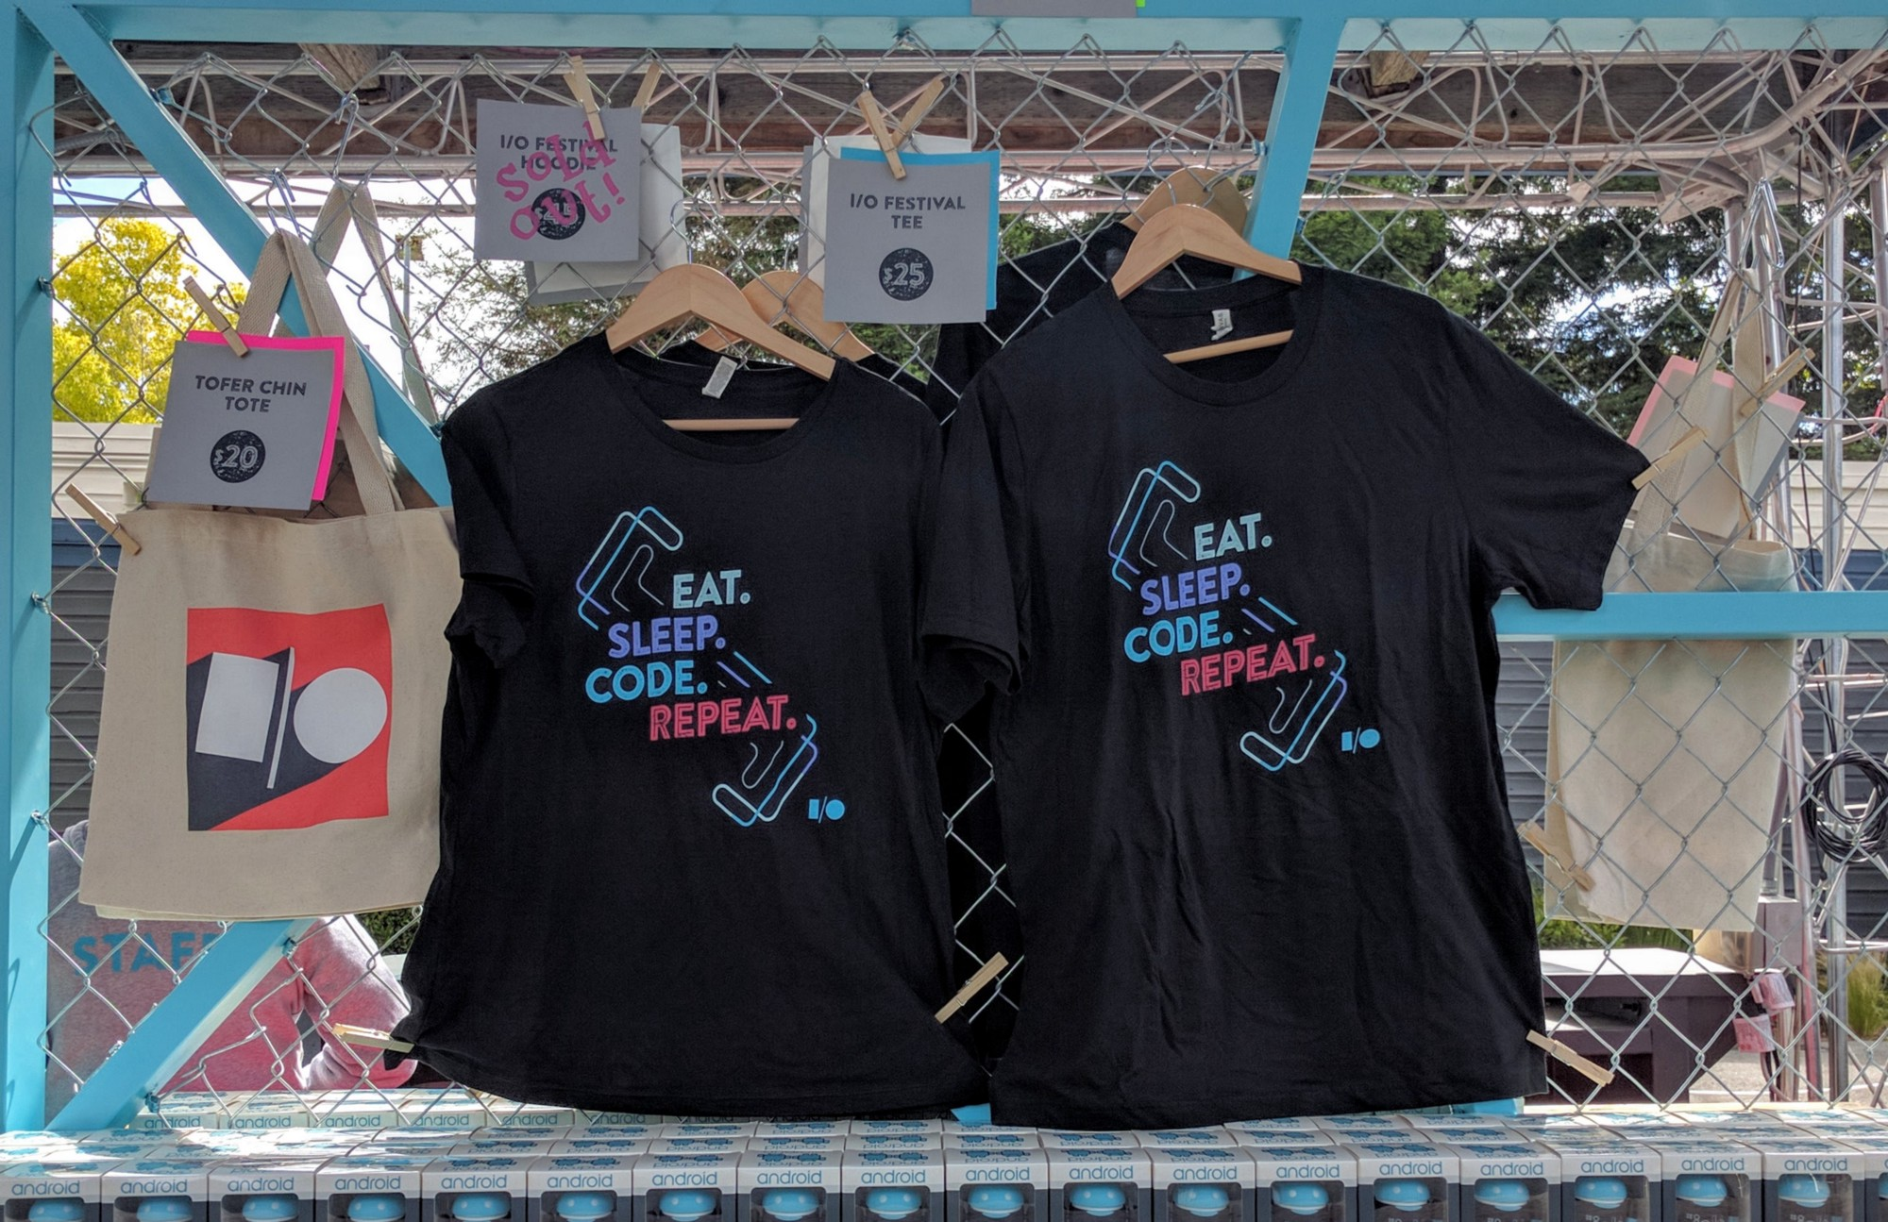
Source: http://m.signalvnoise.com
@dankim

Slide 17
Create a Journal
Source: https://github.com/Kallaway/100-days-kallaway-log

Slide 18
#100DaysOfCode

Slide 19

Source: https://www.linkedin.com/pulse/multitasking-debate-jimmy-le-3100-

Slide 20
Inspiration Is for Amateurs –
The rest of us just show up & get to work
Chuck Close
***(Never had a painter’s block)

